Slide 1

EXPERIMENTOS COM MAIS DE UMA VARIÁVEL INDEPENDENTE

Slide 2
Desenhos fatoriais
Experimentos com duas ou mais VIs
Desenhos fatoriais entressujeitos
Desenhos fatoriais intrassujeitos
Desenhos fatoriais mistos
Exemplo: desenho fatorial misto 2 × 3 × ... × n
Quantidade de números representa número de Vis
Valor do primeiro número representa quantidade de níveis da VI 1
Valor do segundo número representa quantidade de níveis da VI 2
...
Valor do n-ésimo número representa quantidade de níveis da VI n
Produto representa o número de condições no experimento
Notes:
Ward et al. (2017)
- in the present research, we focus on a previously unexplored (but common)
situation: when smartphones are not in use, but are merely present;
- Thornton et al. (2014): found that a visually salient cellphone can impair
performance on tasks requiring sustained attention by eliciting awareness of the
"broad social and informational network . . . that one is not part of at the moment";
- IV, salience: (a) high salience, desk condition: nearby and in sight; (b) medium
salience, pocket/bag condition: nearby and out of sight; (c) low salience, other room
condition: in a separate room; turn off the ring and vibrate so that your phone won't
make any sound;
- DVs: WMC (automated Ospan) and functional fluid intelligence (Gf; Raven); both
measures are sensitive to the current availability of attentional resources;
- groups did not differ on phone-related thoughts. Furthermore, a majority of participants indicated that the location of their phones during the experiment did not affect their performance. These results support the idea that the mere presence of one's smartphone may impair cognitive functioning even when it does not occupy the contents of consciousness;

Slide 3
Exemplos
Memória dependente de contexto (Godden & Baddeley, 1975)
Rotação mental (Shepard & Metzler, 1971)
ETCC e percepção de figura–fundo (Sasia & Cacciamani, 2021)
Cegueira inatencional e eventos dinâmicos (Simons & Chabris, 1999)
Notes:
Ward et al. (2017)
- in the present research, we focus on a previously unexplored (but common)
situation: when smartphones are not in use, but are merely present;
- Thornton et al. (2014): found that a visually salient cellphone can impair
performance on tasks requiring sustained attention by eliciting awareness of the
"broad social and informational network . . . that one is not part of at the moment";
- IV, salience: (a) high salience, desk condition: nearby and in sight; (b) medium
salience, pocket/bag condition: nearby and out of sight; (c) low salience, other room
condition: in a separate room; turn off the ring and vibrate so that your phone won't
make any sound;
- DVs: WMC (automated Ospan) and functional fluid intelligence (Gf; Raven); both
measures are sensitive to the current availability of attentional resources;
- groups did not differ on phone-related thoughts. Furthermore, a majority of participants indicated that the location of their phones during the experiment did not affect their performance. These results support the idea that the mere presence of one's smartphone may impair cognitive functioning even when it does not occupy the contents of consciousness;

Slide 4
Exemplos
Memória dependente de contexto (Godden & Baddeley, 1975)
Rotação mental (Shepard & Metzler, 1971)
ETCC e percepção de figura–fundo (Sasia & Cacciamani, 2021)
Cegueira inatencional e eventos dinâmicos (Simons & Chabris, 1999)
Notes:
Ward et al. (2017)
- in the present research, we focus on a previously unexplored (but common)
situation: when smartphones are not in use, but are merely present;
- Thornton et al. (2014): found that a visually salient cellphone can impair
performance on tasks requiring sustained attention by eliciting awareness of the
"broad social and informational network . . . that one is not part of at the moment";
- IV, salience: (a) high salience, desk condition: nearby and in sight; (b) medium
salience, pocket/bag condition: nearby and out of sight; (c) low salience, other room
condition: in a separate room; turn off the ring and vibrate so that your phone won't
make any sound;
- DVs: WMC (automated Ospan) and functional fluid intelligence (Gf; Raven); both
measures are sensitive to the current availability of attentional resources;
- groups did not differ on phone-related thoughts. Furthermore, a majority of participants indicated that the location of their phones during the experiment did not affect their performance. These results support the idea that the mere presence of one's smartphone may impair cognitive functioning even when it does not occupy the contents of consciousness;

Slide 5




Memória dependente de contexto (Godden & Baddeley, 1975)
VI 1: contexto de codificação
VI 2: contexto de recuperação
Grupos: condificação–recuperação

Slide 6
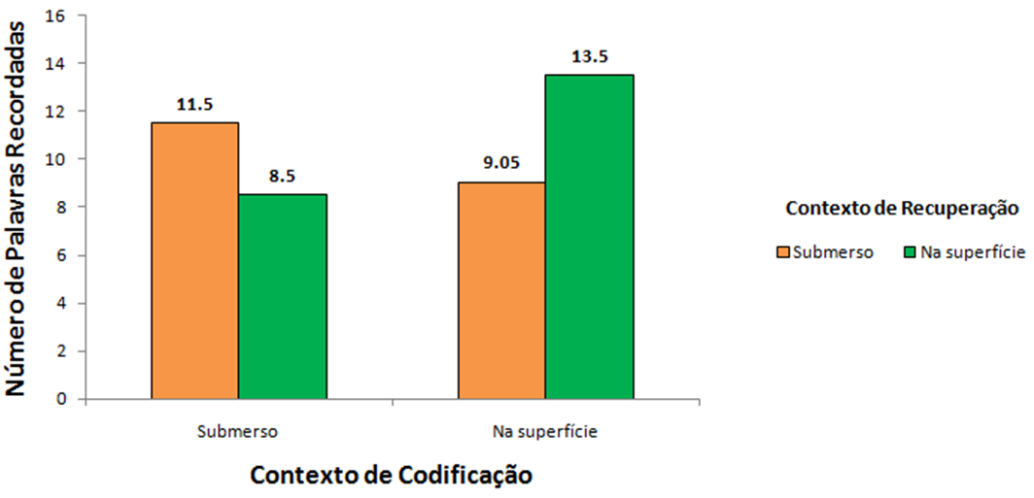
Memória dependente de contexto (Godden & Baddeley, 1975)

Slide 7
Exemplos
Memória dependente de contexto (Godden & Baddeley, 1975)
Rotação mental (Shepard & Metzler, 1971)
ETCC e percepção de figura–fundo (Sasia & Cacciamani, 2021)
Cegueira inatencional e eventos dinâmicos (Simons & Chabris, 1999)
Notes:
Ward et al. (2017)
- in the present research, we focus on a previously unexplored (but common)
situation: when smartphones are not in use, but are merely present;
- Thornton et al. (2014): found that a visually salient cellphone can impair
performance on tasks requiring sustained attention by eliciting awareness of the
"broad social and informational network . . . that one is not part of at the moment";
- IV, salience: (a) high salience, desk condition: nearby and in sight; (b) medium
salience, pocket/bag condition: nearby and out of sight; (c) low salience, other room
condition: in a separate room; turn off the ring and vibrate so that your phone won't
make any sound;
- DVs: WMC (automated Ospan) and functional fluid intelligence (Gf; Raven); both
measures are sensitive to the current availability of attentional resources;
- groups did not differ on phone-related thoughts. Furthermore, a majority of participants indicated that the location of their phones during the experiment did not affect their performance. These results support the idea that the mere presence of one's smartphone may impair cognitive functioning even when it does not occupy the contents of consciousness;

Slide 8
Exemplos
Memória dependente de contexto (Godden & Baddeley, 1975)
Rotação mental (Shepard & Metzler, 1971)
ETCC e percepção de figura–fundo (Sasia & Cacciamani, 2021)
Cegueira inatencional e eventos dinâmicos (Simons & Chabris, 1999)
Notes:
Ward et al. (2017)
- in the present research, we focus on a previously unexplored (but common)
situation: when smartphones are not in use, but are merely present;
- Thornton et al. (2014): found that a visually salient cellphone can impair
performance on tasks requiring sustained attention by eliciting awareness of the
"broad social and informational network . . . that one is not part of at the moment";
- IV, salience: (a) high salience, desk condition: nearby and in sight; (b) medium
salience, pocket/bag condition: nearby and out of sight; (c) low salience, other room
condition: in a separate room; turn off the ring and vibrate so that your phone won't
make any sound;
- DVs: WMC (automated Ospan) and functional fluid intelligence (Gf; Raven); both
measures are sensitive to the current availability of attentional resources;
- groups did not differ on phone-related thoughts. Furthermore, a majority of participants indicated that the location of their phones during the experiment did not affect their performance. These results support the idea that the mere presence of one's smartphone may impair cognitive functioning even when it does not occupy the contents of consciousness;

Slide 9
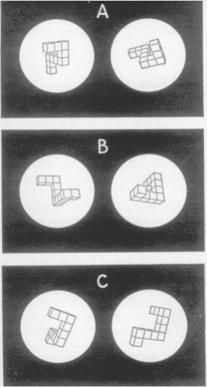
Rotação mental (Shepard & Metzler, 1971)
VI 1—Tipos de pares iguais: no plano da imagem, em profundidade
VI 2—Grau de rotação para atingir a congruência: 0, 20, 40, 60, 80, 100, 120, 140, 160, 180
Pares iguais, no plano da imagem
Pares iguais, em profundidade
Pares diferentes

Slide 10
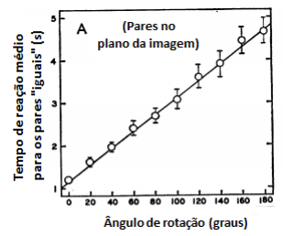
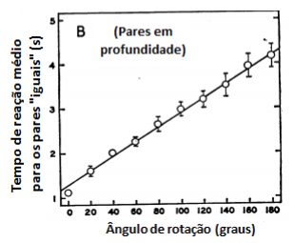
Rotação mental (Shepard & Metzler, 1971)

Slide 11
Exemplos
Memória dependente de contexto (Godden & Baddeley, 1975)
Rotação mental (Shepard & Metzler, 1971)
ETCC e percepção de figura–fundo (Sasia & Cacciamani, 2021)
Cegueira inatencional e eventos dinâmicos (Simons & Chabris, 1999)
Notes:
Ward et al. (2017)
- in the present research, we focus on a previously unexplored (but common)
situation: when smartphones are not in use, but are merely present;
- Thornton et al. (2014): found that a visually salient cellphone can impair
performance on tasks requiring sustained attention by eliciting awareness of the
"broad social and informational network . . . that one is not part of at the moment";
- IV, salience: (a) high salience, desk condition: nearby and in sight; (b) medium
salience, pocket/bag condition: nearby and out of sight; (c) low salience, other room
condition: in a separate room; turn off the ring and vibrate so that your phone won't
make any sound;
- DVs: WMC (automated Ospan) and functional fluid intelligence (Gf; Raven); both
measures are sensitive to the current availability of attentional resources;
- groups did not differ on phone-related thoughts. Furthermore, a majority of participants indicated that the location of their phones during the experiment did not affect their performance. These results support the idea that the mere presence of one's smartphone may impair cognitive functioning even when it does not occupy the contents of consciousness;

Slide 12
Exemplos
Memória dependente de contexto (Godden & Baddeley, 1975)
Rotação mental (Shepard & Metzler, 1971)
ETCC e percepção de figura–fundo (Sasia & Cacciamani, 2021)
Cegueira inatencional e eventos dinâmicos (Simons & Chabris, 1999)
Notes:
Ward et al. (2017)
- in the present research, we focus on a previously unexplored (but common)
situation: when smartphones are not in use, but are merely present;
- Thornton et al. (2014): found that a visually salient cellphone can impair
performance on tasks requiring sustained attention by eliciting awareness of the
"broad social and informational network . . . that one is not part of at the moment";
- IV, salience: (a) high salience, desk condition: nearby and in sight; (b) medium
salience, pocket/bag condition: nearby and out of sight; (c) low salience, other room
condition: in a separate room; turn off the ring and vibrate so that your phone won't
make any sound;
- DVs: WMC (automated Ospan) and functional fluid intelligence (Gf; Raven); both
measures are sensitive to the current availability of attentional resources;
- groups did not differ on phone-related thoughts. Furthermore, a majority of participants indicated that the location of their phones during the experiment did not affect their performance. These results support the idea that the mere presence of one's smartphone may impair cognitive functioning even when it does not occupy the contents of consciousness;

Slide 13


ETCC e percepção de figura–fundo (Sasia & Cacciamani, 2021)

Slide 14
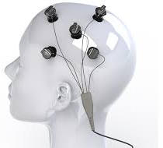
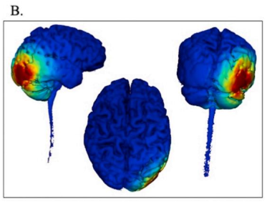
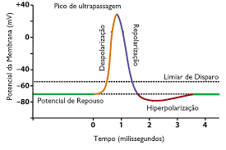
ETCC e percepção de figura–fundo (Sasia & Cacciamani, 2021)
VI 1—Estimulação: estimulação, sham

Slide 15
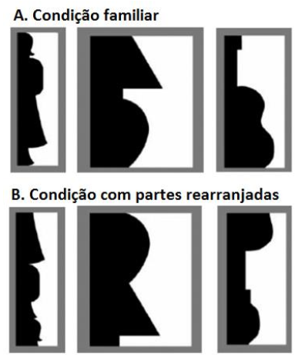
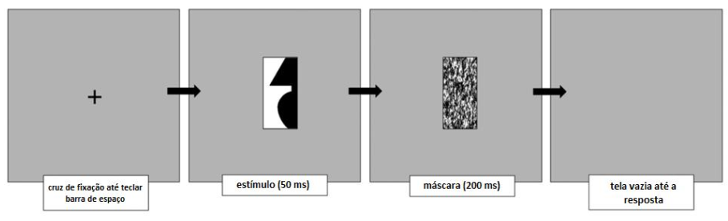
ETCC e percepção de figura–fundo (Sasia & Cacciamani, 2021)
VI 2—Tipo de estímulo: familiar, com partes rearranjadas

Slide 16
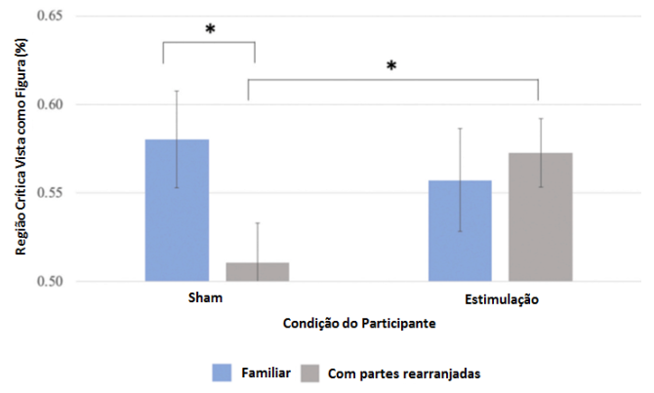
ETCC e percepção de figura–fundo (Sasia & Cacciamani, 2021)

Slide 17
Exemplos
Memória dependente de contexto (Godden & Baddeley, 1975)
Rotação mental (Shepard & Metzler, 1971)
ETCC e percepção de figura–fundo (Sasia & Cacciamani, 2021)
Cegueira inatencional e eventos dinâmicos (Simons & Chabris, 1999)
Notes:
Ward et al. (2017)
- in the present research, we focus on a previously unexplored (but common)
situation: when smartphones are not in use, but are merely present;
- Thornton et al. (2014): found that a visually salient cellphone can impair
performance on tasks requiring sustained attention by eliciting awareness of the
"broad social and informational network . . . that one is not part of at the moment";
- IV, salience: (a) high salience, desk condition: nearby and in sight; (b) medium
salience, pocket/bag condition: nearby and out of sight; (c) low salience, other room
condition: in a separate room; turn off the ring and vibrate so that your phone won't
make any sound;
- DVs: WMC (automated Ospan) and functional fluid intelligence (Gf; Raven); both
measures are sensitive to the current availability of attentional resources;
- groups did not differ on phone-related thoughts. Furthermore, a majority of participants indicated that the location of their phones during the experiment did not affect their performance. These results support the idea that the mere presence of one's smartphone may impair cognitive functioning even when it does not occupy the contents of consciousness;

Slide 18
Exemplos
Memória dependente de contexto (Godden & Baddeley, 1975)
Rotação mental (Shepard & Metzler, 1971)
ETCC e percepção de figura–fundo (Sasia & Cacciamani, 2021)
Cegueira inatencional e eventos dinâmicos (Simons & Chabris, 1999)
Notes:
Ward et al. (2017)
- in the present research, we focus on a previously unexplored (but common)
situation: when smartphones are not in use, but are merely present;
- Thornton et al. (2014): found that a visually salient cellphone can impair
performance on tasks requiring sustained attention by eliciting awareness of the
"broad social and informational network . . . that one is not part of at the moment";
- IV, salience: (a) high salience, desk condition: nearby and in sight; (b) medium
salience, pocket/bag condition: nearby and out of sight; (c) low salience, other room
condition: in a separate room; turn off the ring and vibrate so that your phone won't
make any sound;
- DVs: WMC (automated Ospan) and functional fluid intelligence (Gf; Raven); both
measures are sensitive to the current availability of attentional resources;
- groups did not differ on phone-related thoughts. Furthermore, a majority of participants indicated that the location of their phones during the experiment did not affect their performance. These results support the idea that the mere presence of one's smartphone may impair cognitive functioning even when it does not occupy the contents of consciousness;

Slide 19
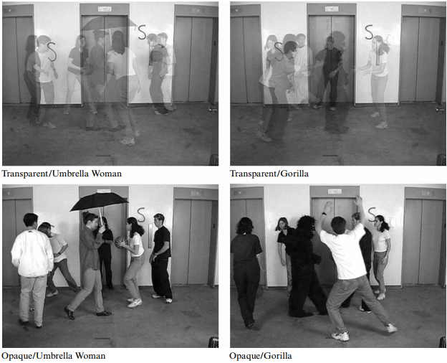
Cegueira inatencional e eventos dinâmicos (Simons & Chabris, 1999)
VI 1—Equipe: branca, preta
VI 2—Tarefa: fácil, difícil
VI 3—Vídeo: transparente, opaco
VI 4—Evento inesperado: Mulher com guarda-chuva, gorila

Slide 20
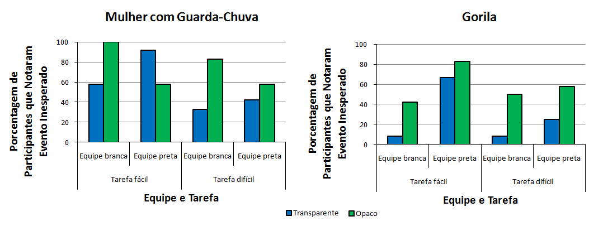
Cegueira inatencional e eventos dinâmicos (Simons & Chabris, 1999)

Slide 21
Próximo vídeo…
O que é efeito de interação
Tipos de interação

Slide 22
ATÉ O PRÓXIMO VÍDEO! ☺

Slide 23
Referências
Godden, D. R., & Baddeley, A. D. (1975). Context-dependent memory in two natural environments: On land and underwater. British Journal of Psychology, 66(3), 325–331. https://doi.org/10.1111/j.2044-8295.1975.tb01468.x
Sasia, B., & Cacciamani, L. (2021). High-definition transcranial direct current stimulation of the lateral occipital cortex influences figure-ground perception. Neuropsychologia, 155, Article 107792. https://doi.org/10.1016/j.neuropsychologia.2021.107792
Shepard, R. N., & Metzler, J. (1971). Mental rotation of three-dimensional objects. Science, 171(3972), 701–703. https://doi.org/10.1126/science.171.3972.701
Simons, D. J., & Chabris, C. F. (1999). Gorillas in our midst: Sustained inattentional blindness for dynamic events. Perception, 28(9), 1059–1074. https://doi.org/10.1068/p281059

